Slide 1

MediSync
Smart Hospital Management System
Revolutionizing healthcare delivery through unified digital operations

Slide 2

The Vision
MediSync simplifies hospital management by integrating all operations into one intelligent platform. From patient care to pharmacy management, billing to emergency response — every function works seamlessly together, reducing administrative burden and improving patient outcomes.
Unified Platform
Streamlined Operations
All departments connected in real-time
Eliminate manual processes and errors
Enhanced Care
Better outcomes through data-driven decisions

Slide 3












Core Modules Overview
MediSync comprises eight integrated modules covering every aspect of hospital operations, each designed to work seamlessly with the others.
Patient Management
Doctor Management
Complete patient profiles, history, and records
Staff scheduling and credential tracking
Emergency Services
Appointments
Ambulance booking with real-time tracking
Smart scheduling and reminders
Billing
Pharmacy
Invoice generation and secure payments
Medicine booking and inventory control

Slide 4
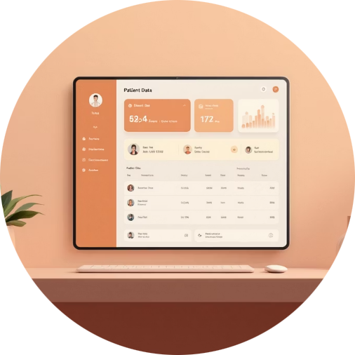


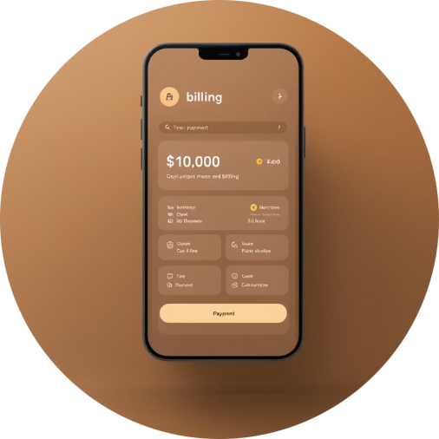


Existing Features
MediSync's current robust feature set ensures comprehensive hospital management, covering essential operations from patient care to emergency response.
Patient & Doctor Management
Appointments & Consultations
Pharmacy & MedScan
Comprehensive patient profiles, medical history, and doctor credential tracking.
Intelligent scheduling system with reminders for both in-person and virtual consultations.
Efficient medicine booking, inventory control, and camera-based medicine information scanner.
Billing & Reports
Lab Services
Ambulance Services
Automated invoice generation, secure payment processing, and detailed financial reporting.
Streamlined lab test ordering, sample management, and quick delivery of results.
Seamless booking, real-time tracking, and efficient coordination for emergency transport.

Slide 5


Patient & Doctor Management
Patient Management
Doctor Management
Centralized patient records including medical history, allergies, current medications, and treatment plans. Complete EHR storage with cloud backup ensures data accessibility and security across all departments.
Streamlined staff management with credential verification, specialization tracking, and intelligent scheduling. Monitor availability, workload, and performance metrics across all physicians.
Complete medical histories
Credential management
Real-time record access
Smart scheduling
Secure cloud storage
Workload balancing
HIPAA compliance
Performance tracking

Slide 6

Appointments & Consultations
Intelligent appointment scheduling matches patients with appropriate physicians based on specialty, availability, and patient needs. The consultation module enables secure video and in-person interactions with automated documentation.
Patient Requests Appointment
Select specialty and preferred time slots
System Recommends Physicians
Matches doctor availability with patient needs
Automated Confirmation
Instant booking with reminder notifications
Secure Consultation
Video or in-person meeting with records updated automatically

Slide 7

Pharmacy & Vital Monitoring
Pharmacy Management
Patient Vital Tracking
Complete medicine booking with real-time inventory tracking. Automated stock alerts, delivery coordination, and expiration date management ensure optimal pharmacy operations and patient safety.
Continuous monitoring of critical health parameters including blood pressure, temperature, oxygen saturation, and pulse rate. Real-time alerts trigger when readings exceed safe thresholds.
BP monitoring
Medicine booking system
Temperature tracking
Inventory tracking
SpO₂ levels
Auto-reorder alerts
Pulse monitoring
Delivery logistics

Slide 8



Billing, Ambulance & Lab Services
Billing & Payments
Ambulance Booking
Lab Management
Streamlined financial operations with automated invoices, secure digital payment integrations (like UPI), comprehensive payment history, and transparent financial reporting.
Rapid emergency response system featuring real-time GPS tracking and automated dispatch to minimize response times and ensure patient safety during transport.
Comprehensive laboratory operations covering test requisition, secure sample tracking, efficient result management, and integrated reporting for seamless patient care coordination.

Slide 9

Health Education and diet management
MediSync seamlessly integrates comprehensive health education with practical diet planning, creating a holistic approach to lasting lifestyle change. Our intelligent system adapts to your progress, preferences, and goals.
Designed specifically for busy lives—the app is simple, engaging, and always accessible right on your smartphone whenever you need it.
->Tailored Daily Guidance
Provides personalized health tips and custom diet plans every day.
Helps you stay on track and empowers your unique wellness journey.
->Expert-Backed Nutrition
Combines evidence-based nutrition guidance with practical, easy-to-follow daily reminders.
Ensures that every recommendation is trustworthy and effective.

Slide 10
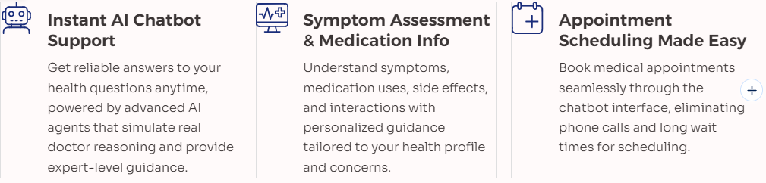
AI-Powered Health Assistant
Continuous Learning & Real-Time Updates
The AI evolves with every interaction, ensuring up-to-date medical insights and tailored advice that improves over time.
Secure & User-Friendly
Protected access to your personal health data with a clean, intuitive interface designed for effortless use by patients of all ages.
Bridging the Healthcare Gap: MediSync reduces wait times and empowers patients with expert-level medical knowledge at their fingertips, transforming how people access and understand healthcare information.

Slide 11




Technology Stack
Our platform leverages modern, enterprise-grade technologies across the full stack to deliver a secure, scalable, and responsive user experience.
Frontend
Backend
Database
React framework with responsive design principles ensures seamless experiences across all devices and screen sizes.
Node.js and Python APIs provide flexible, high-performance server-side processing for complex business logic.
MongoDB for flexible document storage and PostgreSQL for structured relational data, optimizing for different use cases.
Mobile Applications
Cloud Infrastructure
Native iOS and Android apps deliver optimized mobile experiences with offline capabilities and push notifications.
AWS hosting provides scalable, reliable infrastructure with global reach and 99.9% uptime guarantees.
Security First: End-to-end encryption protects all data in transit and at rest, ensuring compliance with industry standards and protecting user privacy.

Slide 12

Benefits & Impact
MediSync transforms hospital operations by improving efficiency, patient satisfaction, and clinical outcomes through intelligent automation and data integration.
60%
40%
99.9%
Administrative Time Reduction
Faster Patient Processing
System Uptime
Reliable 24/7 operations
Less manual paperwork, more patient care
Streamlined admission and checkout
100%
Data Accessibility
Authorized access anywhere, anytime

Slide 13




Future Vision
MediSync continues evolving with emerging technologies. Planned enhancements include AI-powered diagnosis assistance, wearable device integration for continuous monitoring, telemedicine expansion, and predictive patient care models. Together, we're building a smarter, connected healthcare ecosystem where technology amplifies human expertise and patient outcomes thrive.
AI Diagnosis
Machine learning assisted diagnosis
Wearables
Integration with health devices
Telemedicine
Remote care expansion

